Slide 1
CHAT CONNECT:REAL TIME CHAT AND COMMUNICATION APP
-ABIPRABA S
aut711222CS001

Slide 2
DESCRIPTION
A Chat Connect is a versatile tool or system designed to facilitate seamless communication and collaboration in real-time. It serves as an essential application for individuals, teams, and organizations, providing instant messaging, multimedia sharing, and voice/video communication.
Login & Registration System: Users can register or log in with an email and password, ensuring a safe environment. The system includes options like showing/hiding passwords for convenience.
Anonymous Messaging: Chat Connect allows for easy and secure real-time messaging in an anonymous chat room setup, making it ideal for private interactions.
Simple and Intuitive UI: The app features a clean design with straightforward navigation, making it user-friendly for people of all ages.

Slide 3
Main Activity.kt:
package com.example.myapplication
import android.os.Bundle
import androidx.activity.ComponentActivity
import androidx.activity.compose.setContent
import com.google.firebase.FirebaseApp
class MainActivity : ComponentActivity() {
override fun onCreate(savedInstanceState: Bundle?) {
super.onCreate(savedInstanceState)
FirebaseApp.initializeApp(this)
setContent {
NavComposeApp()
}
}
}

Slide 4
NavComposeApp.kt:
package com.example.myapplication
import androidx.compose.runtime.Composable
import androidx.compose.runtime.remember
import androidx.navigation.compose.NavHost
import androidx.navigation.compose.composable
import androidx.navigation.compose.rememberNavController
import com.example.myapplication.nav.Action
import com.example.myapplication.nav.Destination.AuthenticationOption
import com.example.myapplication.nav.Destination.Home
import com.example.myapplication.nav.Destination.Login
import com.example.myapplication.nav.Destination.Register
import com.example.myapplication.ui.theme.MyApplicationTheme
import com.example.myapplication.view.AuthenticationView
import com.example.myapplication.view.home.HomeView
import com.example.myapplication.view.login.LoginView
import com.example.myapplication.view.register.RegisterView
import com.google.firebase.auth.FirebaseAuth
@Composable
fun NavComposeApp() {
val navController = rememberNavController()
val actions = remember(navController) { Action(navController) }

Slide 5
MyApplicationTheme {
NavHost(
navController = navController,
startDestination =
if (FirebaseAuth.getInstance().currentUser != null)
Home
else
AuthenticationOption
) {
composable(AuthenticationOption) {
AuthenticationView(
register = actions.register,
login = actions.login
)
}
composable(Register) {
RegisterView(
home = actions.home,
back = actions.navigateBack
)
}

Slide 6
composable(Login) {
LoginView(
home = actions.home,
back = actions.navigateBack
)
}
composable(Home) {
HomeView()
}
}
}
}

Slide 7
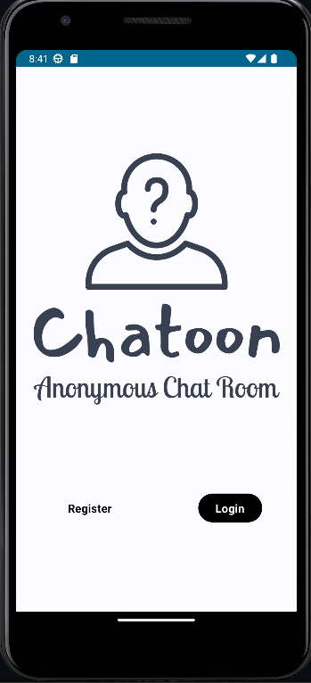
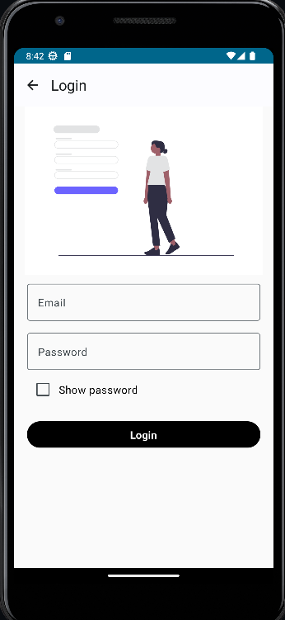
OUTPUT:

Slide 8
